Slide 1
Lecture 15
Lecture 14 Review
Error, Alpha, Beta, and Power

Slide 2
Today’s Updates / Reminders
Homework 7 is due at the end of the day, next class.
Quiz 7 will be open Thursday-Friday as always.
Exam 2 review next class. Exam review and key have been posted.
Exam 2 on Monday, October 27.
Last day to drop is coming up… Thursday, October 23. Come see me if you want to talk over this decision.
Stat Hub is open for business. Free help/tutoring. SAS1101, M-Th, 5:30-8:00pm

Slide 3
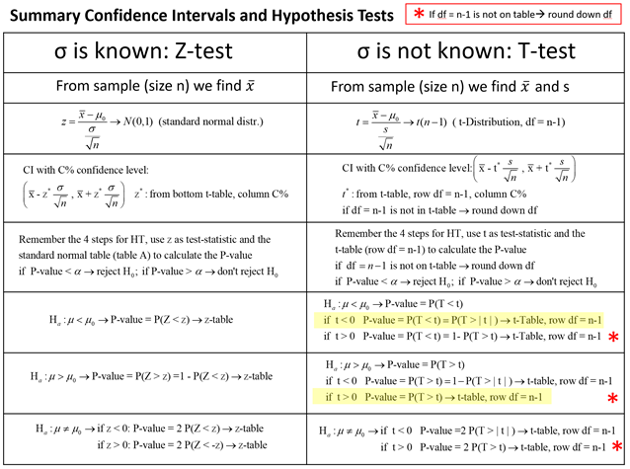
Z vs. T

Slide 4
Review of Lecture 14
Chapter 7.5 – one-sample t-test
  If we wish to test a hypothesis about a mean where we do not know σ or do not know anything about the normality of the population
Chapter 7.6 – one-sample z proportion
  If we wish to test a hypothesis about a proportion where we have at least 10 successes and 10 failures

Slide 5
One-Sample t-test Review

Slide 6

One-sample mean HT, t-table approach
A study is carried out to measure the
production of cucumbers in a farm. You
are told that the mean production of
cucumbers produced in the whole region is
42. Studying 10 plots of land, it is found
that the mean number of cucumbers
produced is 34 with a standard
deviation of 12.75. Conduct a hypothesis
test with α = 0.05 to determine if the
mean production of cucumbers in the
whole region is less than 42.
En.wikipedia.org

Slide 7
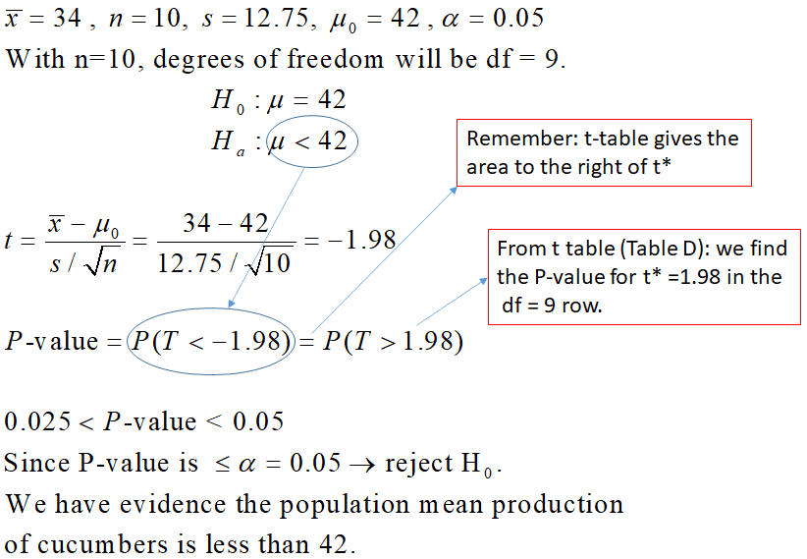
1
2
3
4

Slide 8
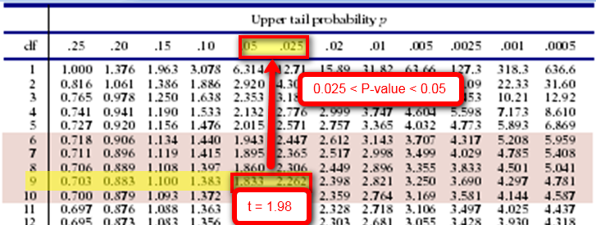
Using the t table to get a P-value

Slide 9
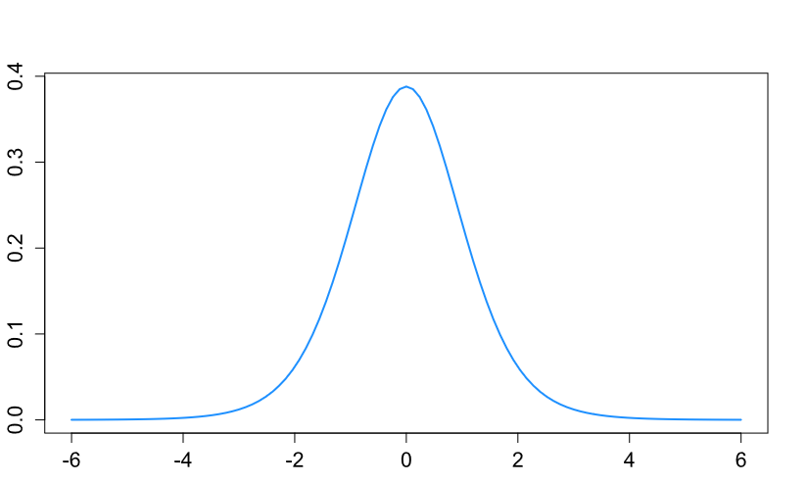
t(9) distribution
P-value= P(T<-1.98)<0.05

Slide 10
Guidelines for One Sample t-Test
When is it ok to use the t procedures?
Sample size | Use t procedures
n < 15 | if your data looks like a Normal distribution (you can check this with a Normal Quantile Plot)
15 ≤ n < 40 | except in the presence of outliers or strong skewness. Some skewness is ok!
n ≥ 40 | except in the presence of outliers, ok even if data are very skewed.
Investigate the cause: data wrongly recorded, equipment malfunction,
Response bias
Use different procedure

Slide 11
How do you check to see if your data are Normally distributed? How to check for skewness and outliers?
Histogram/stemplot/boxplot→ good to see skewness
Modified boxplot →good to see outliers
Normal quantile plot→ good to check for normality
Previous example: sample size n=12 < 15 → data need to show normality!

Slide 12
One-Sample Proportion

Slide 13
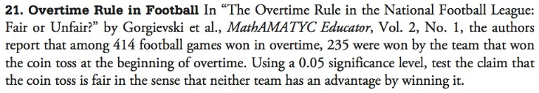

NFL Overtime Rules
  The NFL instituted a new overtime rule, just for playoff games, beginning in 2022.
  https://www.espn.com/nfl/story/_/id/33622482/teams-assured-possession-playoff-rules-change
  State the hypothesis for this problem.
$$H_{0}:{p}=0.5 \\ H_{a}:{p}≠0.5$$

Slide 14
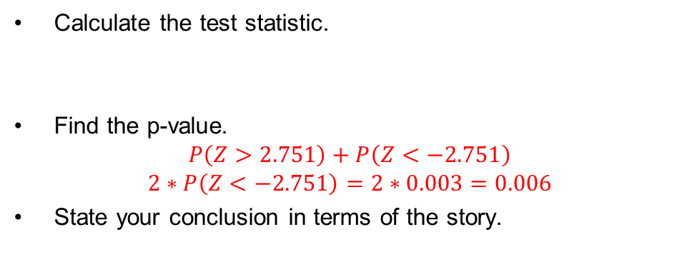
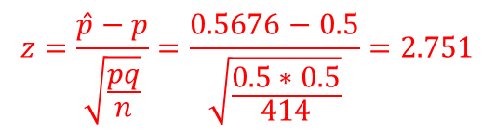
Calculate the test statistic.
Find the p-value.
$$P\left(Z>2.751\right)+P\left(Z<−2.751\right)$$
$$2∗P\left(Z<−2.751\right)=2∗0.003=0.006$$
State your conclusion in terms of the story.
$$z=\frac{\hat{p}−p}{\sqrt{\frac{pq}{n}}}=\frac{0.5676−0.5}{\sqrt{\frac{0.5∗0.5}{414}}}=2.751$$
P-value = 0.006 < 0.05; there is evidence to conclude that the probability of winning the game based on winning the coin toss is different from 50%.

Slide 15
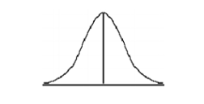

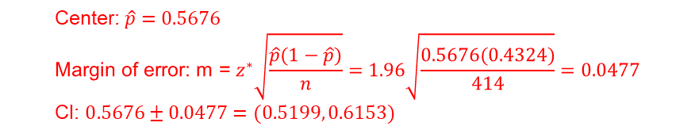

On the curve below, insert and clearly label the p₀, the $\hat{p}$, and the P-value for the hypothesis test.
Construct a 95% confidence interval for the proportion of games won by the team that won the coin toss.
0.003
0.003
P₀=0.5
$\hat{p}$=0.5676
$$\text{Center}\text{:}​ \hat{p}=0.5676 \\ \text{Margin} \text{of} \text{error}\text{: }\text{m}\text{ = }z^{∗}\sqrt{\frac{\hat{p}(1−\hat{p})}{n}}=1.96\sqrt{\frac{0.5676(0.4324)}{414}}=0.0477 \\ \text{CI}\text{: }0.5676±0.0477=(0.5199, 0.6153)$$

Slide 16
Chapter 7.8
Calculating Type II Error Probabilities (β)

Slide 17
Error
When we do hypothesis testing, there is a chance we make a mistake in our conclusions.
If we think of our hypothesis conclusions in the frame of a court of law, we have two possible undesirable outcomes:
  An innocent person goes to prison
  A guilty person walks free
In fact, you can spend some time meditating over a cup of tea about the ethics of this. For example, El Salvador has a new president that prefers the former error and Honduras has followed suit.

Slide 18
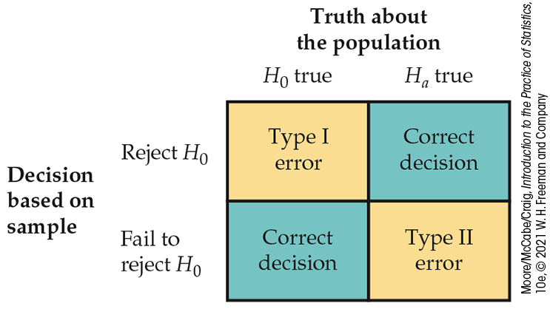
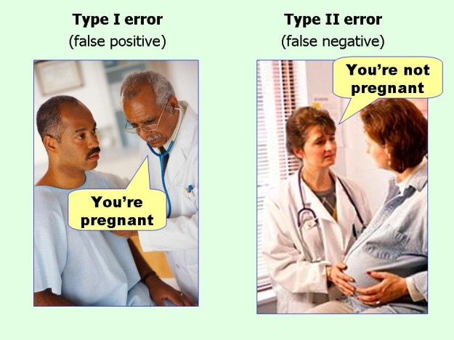
Error Types
If we reject H₀ when H₀ is true, we have committed a Type I error.
If we fail to reject H₀ when H₀ is false, we have committed a Type II error.
α
Power
Status
Quo
β

Slide 19

Hypothesis Test Example
Your brand new car is supposed to get 35 miles per gallon. You have measured your fuel mileage on 10 tanks of gas and you are getting 31.9 mpg with a standard deviation of 5.3. This seems low… but is it really that bad? But, it is the average of 10 tanks tho. Use significance level of 0.05.
  Write the null and alternative hypotheses.

Slide 20

Hypothesis Test Example
μ = 35, $\overline{x}$ = 31.9, s = 5.3 (in fact, let’s assume this is σ)
Calculate the test statistic.
Find the p-value.

Slide 21
Hypothesis Test Example
While you’re looking at the table, we said α = 0.05. What would z have to be in order for the p-value to be ≤ 0.05?
What is your conclusion in technical terms?
Now, you’re ready to go get snooty with the car salesman. Given that we rejected H_{0,} describe the Type I error. Describe the Type II error.

Slide 22
Alpha
The probability of a Type I error is the probability of rejecting H₀ when it really is true. This is exactly the significance level of the test.
The significance level α of any fixed-level test is the probability of a Type I error. That is, α is the probability that the test will reject the null hypothesis H₀ when H₀ is, in fact, true.
This value is chosen from the outset (Step 0!) and cannot be modified by changing sample size, decreasing standard deviation, or changing your hypotheses.
Consider the consequences of a Type I error before choosing a significance level. By this, we mean:
  “What if an error would cause a loss of human life?” Very low α
  “What if an error caused the snack company to not stock enough Doritos in the snack machine?” ‘Less low’ α.
  Common values for α are 0.01, 0.05, and 0.10… 0.05 is most common.

Slide 23

Beta
A significance test makes a Type II error when it fails to reject a null hypothesis that really is false (β). There are many values of the parameter that satisfy the alternative hypothesis.
The easiest way to reduce β is to increase sample size.
We can calculate the probability that a test does reject H₀ when any specific alternative is true. This probability is called the power of the test against that specific alternative.
In the Wienermobile example, we can show the probability that I choose H₀ when I should have chosen H_{a} was 0.4189. So what is the probability that I choose H_{a} when I should have chosen H_{a}? P(A) = P(A|B) + P(A|B’)

Slide 24
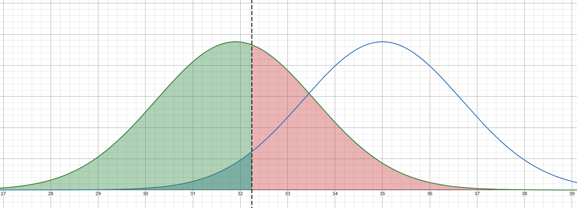
Alpha, Beta, and Power
Desmos
Choose H_{a}
Choose H₀
Alpha
Beta
Power

Slide 25
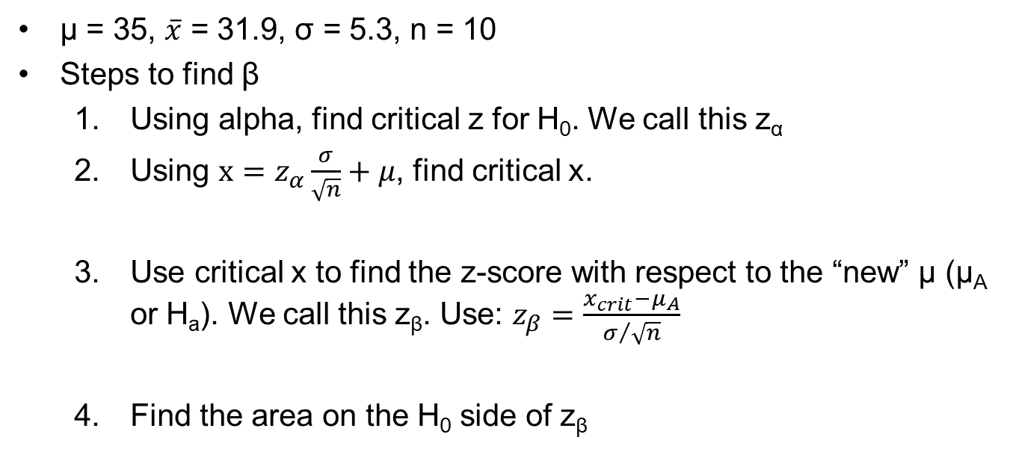
Beta (β)
μ = 35, $\overline{x}$ = 31.9, σ = 5.3, n = 10
Steps to find β
  Using alpha, find critical z for H₀. We call this z_{α}
  Using $x=z_{α}\frac{σ}{\sqrt{n}}+μ$, find critical x.
  Use critical x to find the z-score with respect to the “new” μ (μ_{A} or H_{a}). We call this z_{β}. Use: $z_{β}=\frac{x_{crit}−μ_{A}}{σ/{\sqrt{n}}}$
  Find the area on the H₀ side of z_{β}

Slide 26
Increasing the Power / Decreasing β
Suppose we have performed a power calculation and found that the power is too small. There are four ways to increase power:
Increase the significance level α. It is easier to reject a null hypothesis with a larger α level.
Consider another value for μ that is farther from the null value. Values of μ that are farther from the hypothesized value are easier to detect. This is called effect size.
Increase the sample size. More data will provide better information about the sample average, so we have a better chance of distinguishing values of μ.
Decrease σ. Improving the measuring process and restricting attention to a subpopulation are possible ways to decrease σ.

Slide 27

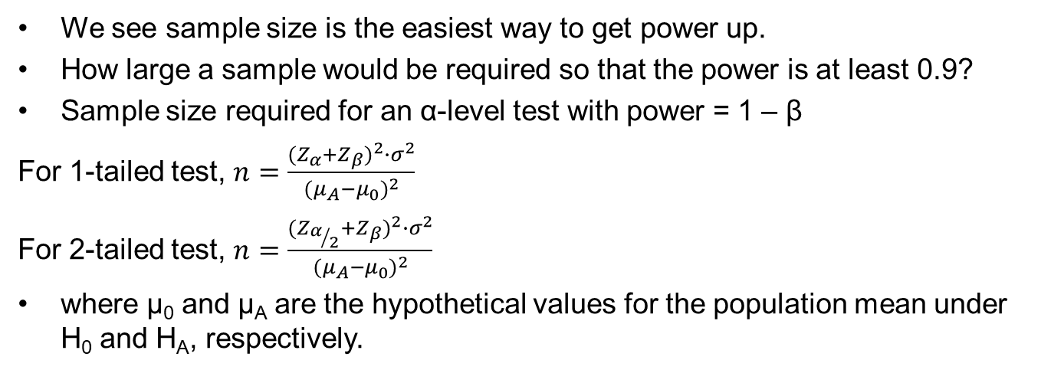
Sample Size Determination
We see sample size is the easiest way to get power up.
How large a sample would be required so that the power is at least 0.9?
Sample size required for an α-level test with power = 1 – β
For 1-tailed test, $n=\frac{{(Z_{α}+Z_{β})}^{2}∙σ^{2}}{{(μ_{A}−μ_{0})}^{2}}$
For 2-tailed test, $n=\frac{{(Z_{α/2}+Z_{β})}^{2}∙σ^{2}}{{(μ_{A}−μ_{0})}^{2}}$
where μ₀ and μ_{A} are the hypothetical values for the population mean under H₀ and H_{A}, respectively.
 | Critical z (Two Tails) | Critical z (One Tail)
α = 0.10 | z = ±1.645 | z = -1.28 or z = 1.28
α = 0.05 | z = ±1.96 | z = -1.645 or z = 1.645
α = 0.01 | z = ±2.576 | z = -2.33 or z = 2.33

Slide 28

Power Calculation Example
DJ Burns Power
DJ Burns wishes to conduct the following test: H₀: μ ≤ 0 vs. H_{a}: μ > 0 using α = 0.05.
Assume that the population SD σ = 6.6 and n = 36.
What is the power of the test to detect a true μ = 2.5? Also stated as β(2.5).

Slide 29
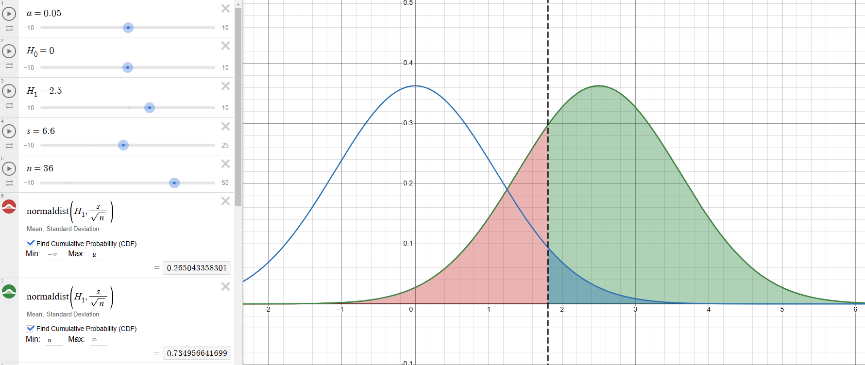
Desmos Results

Slide 30
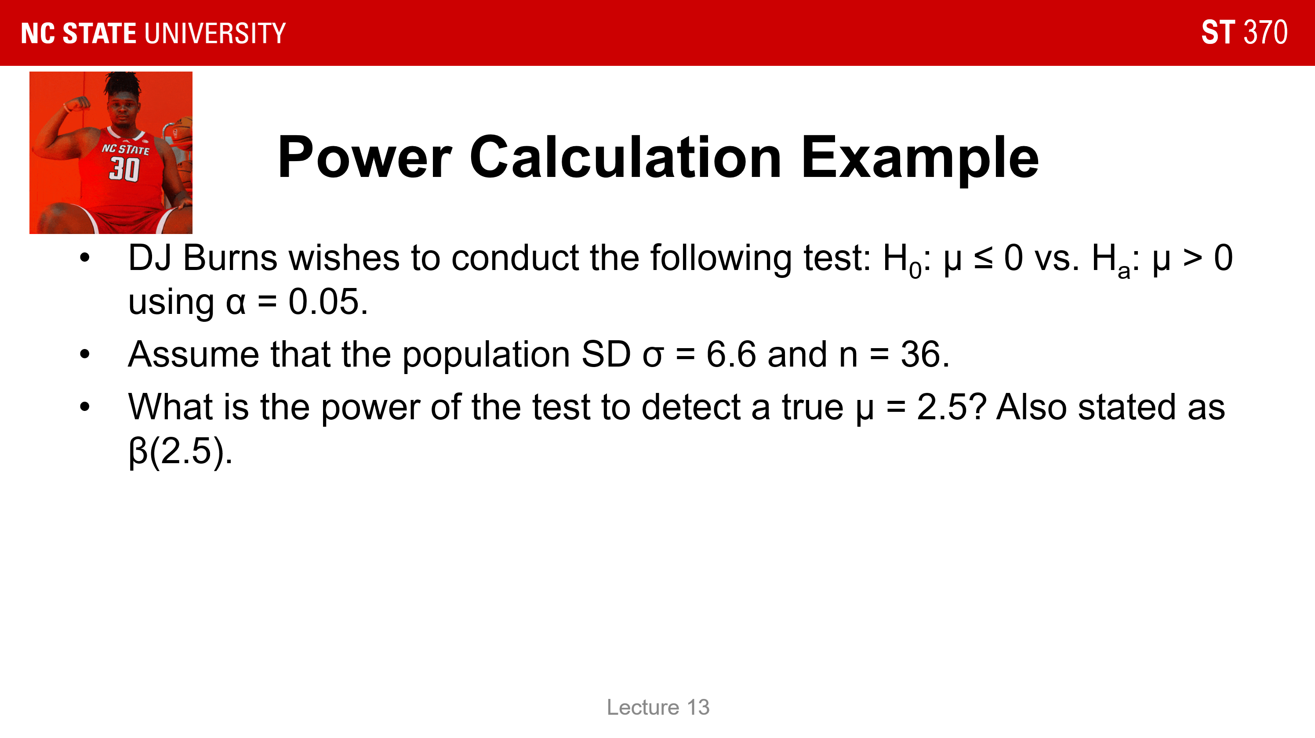
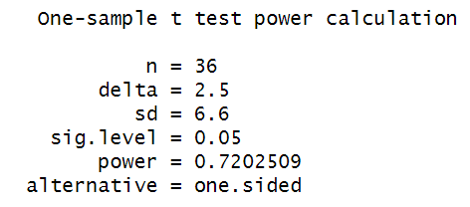
Alpha / Beta / Power Using R
We talked about how we must use σ to avoid using numerical methods to find beta or power.
Using R, you can quickly run this calculation using t-procedures.
Go to R and try these commands:
power.t.test(n=36, delta=2.5, sd=6.6, sig.level=0.05, type='one.sample’, alternative='one.sided')

